Slide 1
CRYPTOGRAPHY
Public Key Cryptography & RSA

Slide 2
Public Key Cryptography
Public Key Cryptography
The RSA Algorithm

Slide 3
Public Key Cryptography
Asymmetric or public key encryption is a form of a cryptosystem in which encryption and decryption are performed using the different keys-one a public key and one a private key
  It is computationally infeasible to determine the decryption key given only knowledge of the cryptographic algorithm and the encryption key
The public key is available to everyone at the sending end
The secret key is known only to the recipient of the message
The public and the private key are related in such a way that only the public key can be used to encrypt (decrypt) a message and only the corresponding private key can be used to decrypt (encrypt) the message
The most widely used algorithm is RSA
Elliptic Curve Cryptography is now also becoming popular
Public Key cryptography offer secrecy or authentication or both.

Slide 4
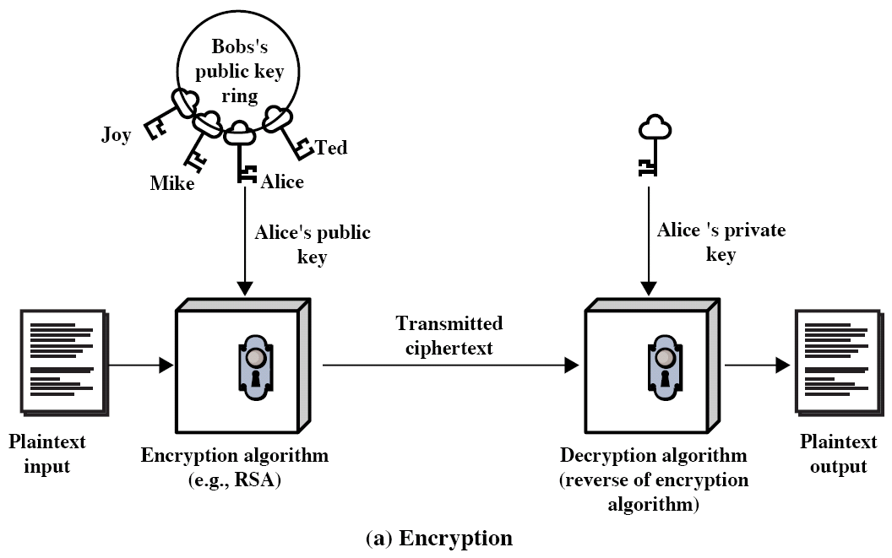
Public Key Cryptography

Slide 5
Public Key Cryptography
Diffie and Hellman first publicly introduced the concepts of public-key cryptography in 1976
public-key cryptography evolved from an attempt to attack two of the most difficult problems associated with the symmetric encryption
  Key distribution
  Digital signatures
Based on mathematical functions rather than on substitution and permutation
Radical departure from conventional cryptography

Slide 6
Public Key Cryptography
Misconceptions concerning public-key cryptography
  Public-key cryptography is more secure than symmetric cryptography
  Public-key cryptography is general-purpose technique that has made symmetric cryptography obsolete
  Key distribution is trivial when using public-key cryptography, compared with the rather cumbersome handshaking involved with KDCs for symmetric cryptography

Slide 7
Conventional and Public-Key Encryption
Conventional (Symmetric)
Needed to work:
Same algorithm, Same key for encryption and decryption
Parties share the algorithm and the key
Needed for Security:
Key must be kept secret
It must be impossible at least impractical to decipher a message if no other information is available
Plaintext/ciphertext pairs must
Knowledge of the algorithm plus samples of cipher-text must be insufficient to determine the key
Public-Key (Asymmetric)
Needed to work:
Same algorithm but different keys used for encryption and decryption
Parties share algorithm but each has one key from a matched pair
Needed for Security:
One key must be kept secret
It must be impossible at least impractical to decipher a message if no other information is available
Knowledge of the algorithm plus one of the keys plus samples of cipher text must be insufficient to determine the key

Slide 8
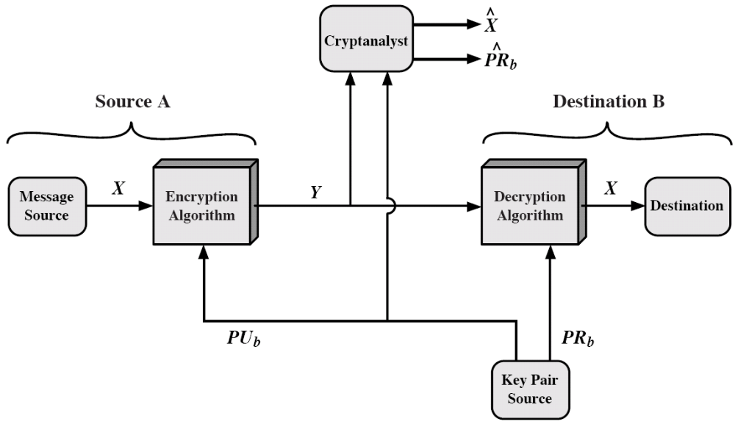
PKC: Secrecy
Y = EPU_{b}(X)
X = DPR_{b}(Y)
PUb: B’s public key
PRb: B’s private key

Slide 9
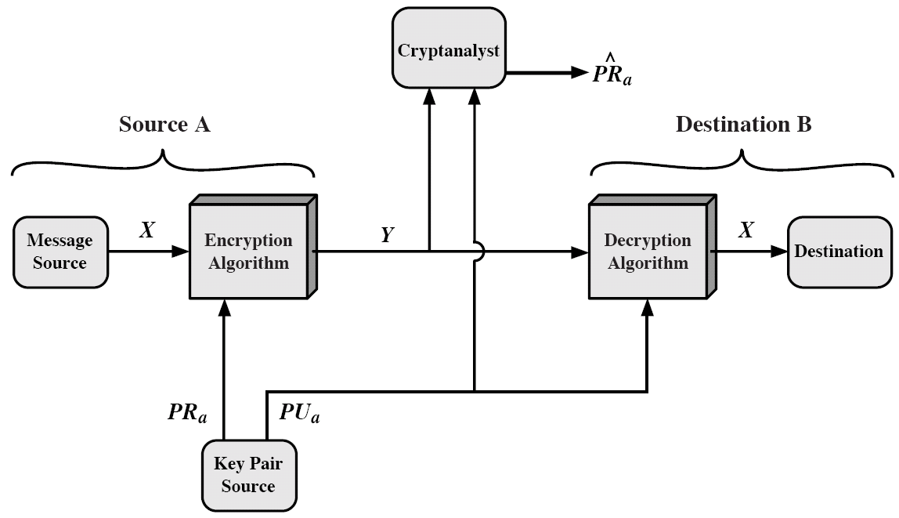
PKC: Authentication
Y = EPR_{b}(X)
X = DPU_{b}(Y)
No protection of confidentiality

Slide 10
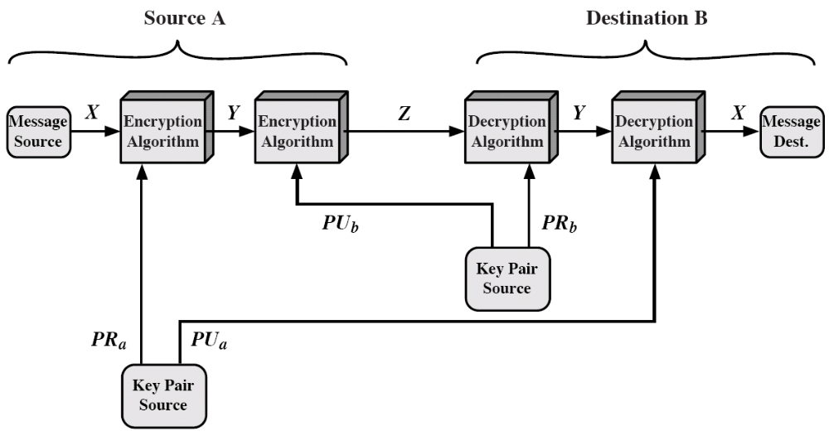
PKC: Secrecy and Authentication
Z = EPU_{b}[EPR_{a}(X)]
X = DPU_{a}[DPR_{b}(Z)]

Slide 11
Requirements for PKC
By Diffie and Hellman, in 1976
Key pair generation is computationally easy
Encryption is computationally easy
Decryption is computationally easy
Computationally infeasible for an adversary to determine private key given public key
Computationally infeasible for an adversary to recover plaintext given public key and ciphertext
Can be added:
Encryption and decryption functions can be applied in either order
  M = D_{PUb}[E_{PRb}(M)] = D_{PRb}[E_{PUb}(M)]

Slide 12
The RSA Algorithm
“It is not what it is, but what it seems to be”
W. Shakespeare
The RSA algorithm was invented by Rivest, Shamir and Adleman in 1977.
Let p and q be two distinct large random primes. The modulus n is the product of these two primes, n=pq
Euler’s totient function of n is given by
Φ(n)=(p-1)(q-1)
Now, let us select a number 1<e< Φ(n) such that
gcd(e, Φ(n))=1
and compute d with
d=e⁻¹(mod Φ(n))
using the extended Euclid's algorithm. Under this scheme, e is the public exponent and d is the private exponent. Usually, one selects a small public exponent (e.g., e=2¹⁶+1).
The modulus n and the public exponent e are published. The value of d and the prime numbers p and q are kept secret.

Slide 13
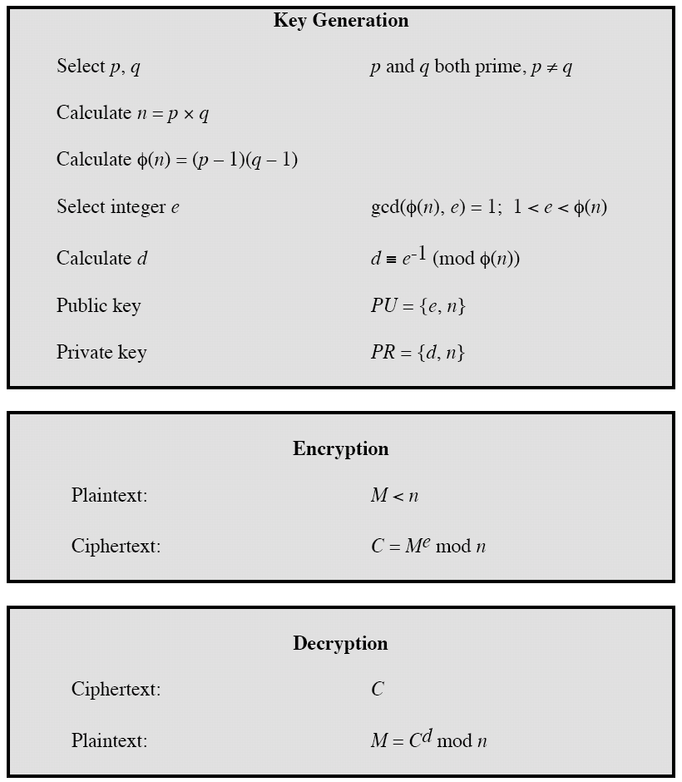
RSA Algorithm

Slide 14

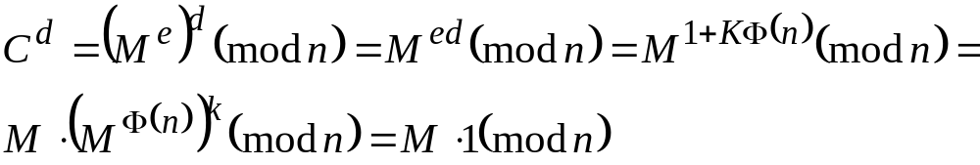
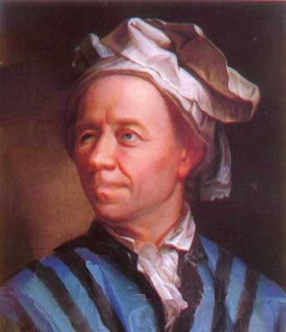
The RSA Algorithm
The correctness of the RSA algorithm follows from Euler's theorem, which in turn is an extension of Fermat's little theorem,
Euler’s Theorem: Let n and a be positive, relatively prime integers.
Then
Proof: Since we have ed=1mod Φ(n), we can write ed=1+K Φ(n), for some
integer K . Hence,
provided that gcd(M,n)=1.

Slide 15
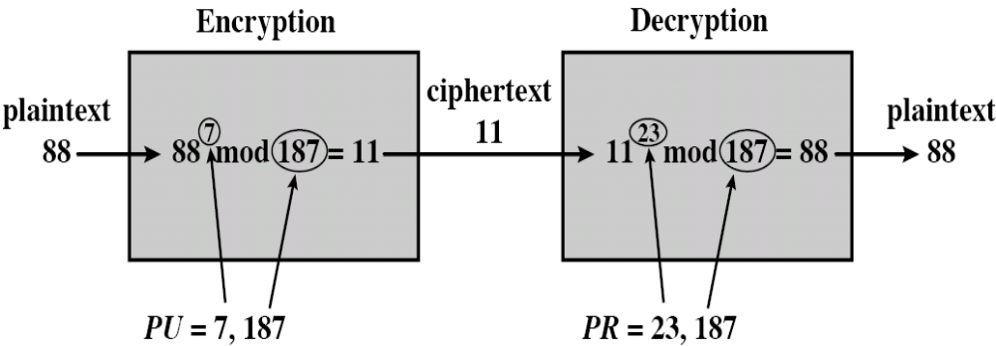
RSA Example
Select two primes, p = 17 and q = 11
Calculate n = pq = 17 × 11 = 187
Calculate φ(n) = (p-1)(q-1) = 16 × 10 = 160
Select e s.t. e is relatively prime to φ(n) and less than φ(n); in this case, e = 7
Determine d s.t. de ≡ 1 mod 160 and d < 160. The correct value is d = 23 (7 × 23 = 161 = 160 + 1)
PU = {7, 187}, PR = {23, 187}

Slide 16
Computational Aspects
Encryption and Decryption
  Both require modular exponentiation
  Can use the following efficient algorithm to compute a^{b} mod n
  Square and multiply
Key Generation
  Determining two prime numbers, p and q (Miller-Rabin Test)
  Selecting either e or d and calculating the other (Extended Euclid)
Modular-Exponentiation(a, b, n)
d ← 1
let bkbk-1…b0 be the binary representation of b
for i ← k downto 0 do
d ← (d × d) mod n
if bi = 1 then d ← (d × a) mod n
return d

Slide 17
Efficient Decryption
Decryption uses exponentiation to power d
  This is likely large, insecure if not
Can use the CRT to compute mod p & q separately, then combine to get desired answer
  V_{p} = C^{d (mod p-1)} mod p, V_{q} = C^{d (mod q-1)} mod q
  X_{p} = q × (q⁻¹ mod p), X_{q} = p × (p⁻¹ mod q) (precomputed)
  M = (V_{p}X_{p} + V_{q}X_{q}) mod n (by CRT)
  Approximately 4 times faster than doing directly
Only owner of private key who knows values of p & q can use this technique

Slide 18
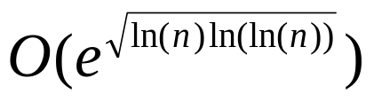
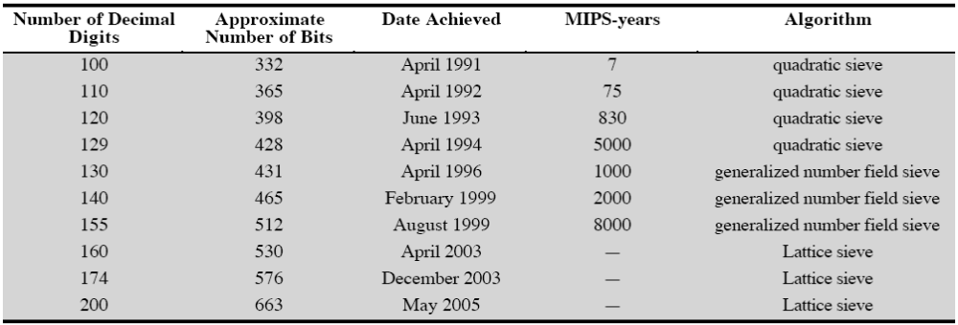
Factoring
For a large n with large prime factors, factoring is a hard problem -
RSA factoring challenge
  Sponsored by RSA Labs.
  To encourage research into computational number theory and the practical difficulty factoring large integers
  A cash prize is awarded to the first person to factor each challenge number
Progress in Factorization

Slide 19
RSA Factoring Challenge
Latest result is RSA 200 (663 bits)
  Reported May 2005
Factored with Lattice Sieve
55 years on a single 2.2GHz Opteron CPU
  Matrix step : 3 months on a cluster of 80 2.2GHz Opterons
  Sieving began in late 2003 and matrix step was completed in May 2005

Slide 20
RSA Algorithm
RSA Factoring Challenge
Numbers are designated “RSA-XXXX”, where XXXX is the
number’s length in bits
Challenge Number Prize ($US) Status
RSA-576 (174 Digits) $10,000 Factored (Dec 2003)
RSA-640 (193 Digits) $20,000 Factored (Nov 2005)
RSA-704 (212 Digits) $30,000 Not Factored
RSA-768 (232 Digits) $50,000 Not Factored
RSA-896 (270 Digits) $75,000 Not Factored
RSA-1024 (309 Digits) $100,000 Not Factored
RSA-1536 (463 Digits) $150,000 Not Factored
RSA-2048 (617 Digits) $200,000 Not Factored
RSA-704
Decimal Digits: 212
74 03756 34795 61712 82804 67960 97429 57314 25931 88889
23128 90849 36232 63897 27650 34028 26627 68919 96419 62511
78439 95894 33050 21275 85370 11896 80982 86733 17327 31089
30900 55250 51168 77063 29907 23963 80786 71008 60969 62537
93465 05637 96359

